Slide 1




WhatsApp-A-Mole
An Interactive Way
of Generating Awareness
on User Privacy on WhatsApp
Notes:
Cover for Behance

Slide 2
WhatsApp-A-Mole
An Interactive Way of Generating Awareness on User Privacy on WhatsApp

Slide 3
WhatsApp-A-Mole
An Interactive Way of Generating Awareness on User Privacy on WhatsApp

Slide 4
WhatsApp-A-Mole
An Interactive Way of Generating Awareness on User Privacy on WhatsApp

Slide 5
TABLE OF CONTENTS
PITCH
OUR JOURNEY
THE GAME
USER TESTIMONIALS
FUTURE DIRECTION
What is our idea?
Our journey through the project
Getting you to play our game :D
What users had to say about our game
What we want to do in the future

Slide 6
PROBLEM STATEMENT
Users heavily rely on WhatsApp and feel safe on it, with incomplete knowledge of its privacy concerns. There is a gap between the understanding of privacy concerns on WhatsApp and its users.

Slide 7


PITCH
WhatsApp-A-Mole is an interactive and fun game that is curated for all age groups. The aim of the game is to make users aware about their privacy and security. This is done through questions about privacy and security on WhatsApp and whacking the correct mole. The game leverages its uniquely custom made art style to make it appropriate to all age groups. The younger generations can enjoy it with the visual activity and gamification aspect while the throwback arcade style appeals to the older generations.

Slide 8






OUR JOURNEY
USER STUDY
PROTOTYPE
PROTOTYPE REVISION
FUTURE DIRECTION
IDEATION
USER EVALUATION
USER FEEDBACK

Slide 9
USER STUDY
Results of Thematic Analysis of the Qualitative Data from the Interviews and Cluster Analysis of Quantitative Data from the Survey

Slide 10
RESEARCH METHODOLOGY
User Survey
An online survey consisting questions on perceptions of safety on WhatsApp, privacy settings used and understanding of privacy policy.
320+ informants covering different age groups and educational backgrounds.
User Interviews
Survey was followed by semi-structured interviews around the same themes. Unlike the binary responses, here we dwelled into perceptions of informants in depth.
Conducted over voice call for 8 informants, spread across various age brackets.

Slide 11
THEMES
How does it work?
Popular Social Media
Differences in Understanding
Technical Jargon
Age and Awareness
Blind Trust
“I use WhatsApp every 5 minutes.” -P2, 53 years
“Not sure what WhatsApp does with data, but it does collect data” - P1, 19 years
“I have not read the policy, its difficult to read like mutual funds policies, too big to read and understand”
-P3, 53 years
“What I text is coded, not even WhatsApp can read again. I am not sure, but no one can read it. Not a tech person, so I cannot question it if it works as said…” -P1, 19 years
“I don’t change settings. Everyone knows everyone is online and there is no need to hide such information.”
-P2, 53 years
“Never seen anyone saying ‘my WhatsApp was hacked’.” -P3, 53 years

Slide 12
REQUIREMENTS
> An effective way of presenting the lengthy privacy policy of WhatsApp
> Helping users understand different privacy settings and use the ones best for their requirements
> Awareness on how to keep their experience on WhatsApp secure

Slide 13
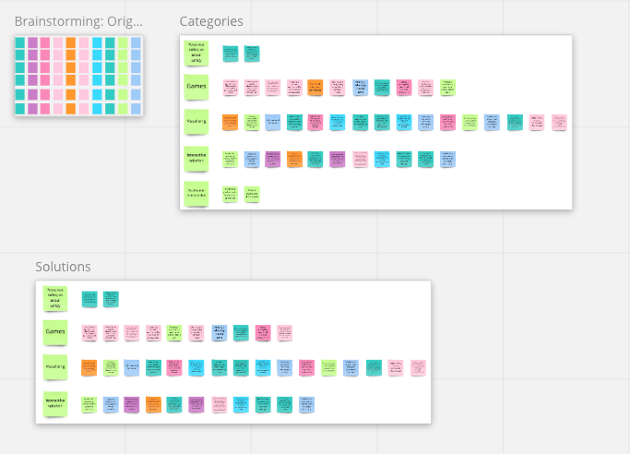
IDEATION
https://miro.com/app/board/o9J_lLhYYnE=/

Slide 14
SELECTED SOLUTION
WhatsApp-A-Mole is a game curated for all age groups - the young ones who love games, and the older generations who enjoyed arcade games back in the day.
Questions related to privacy and security on WhatsApp pop up, if one hits the mole with the correct answer, they gain points!

Slide 15
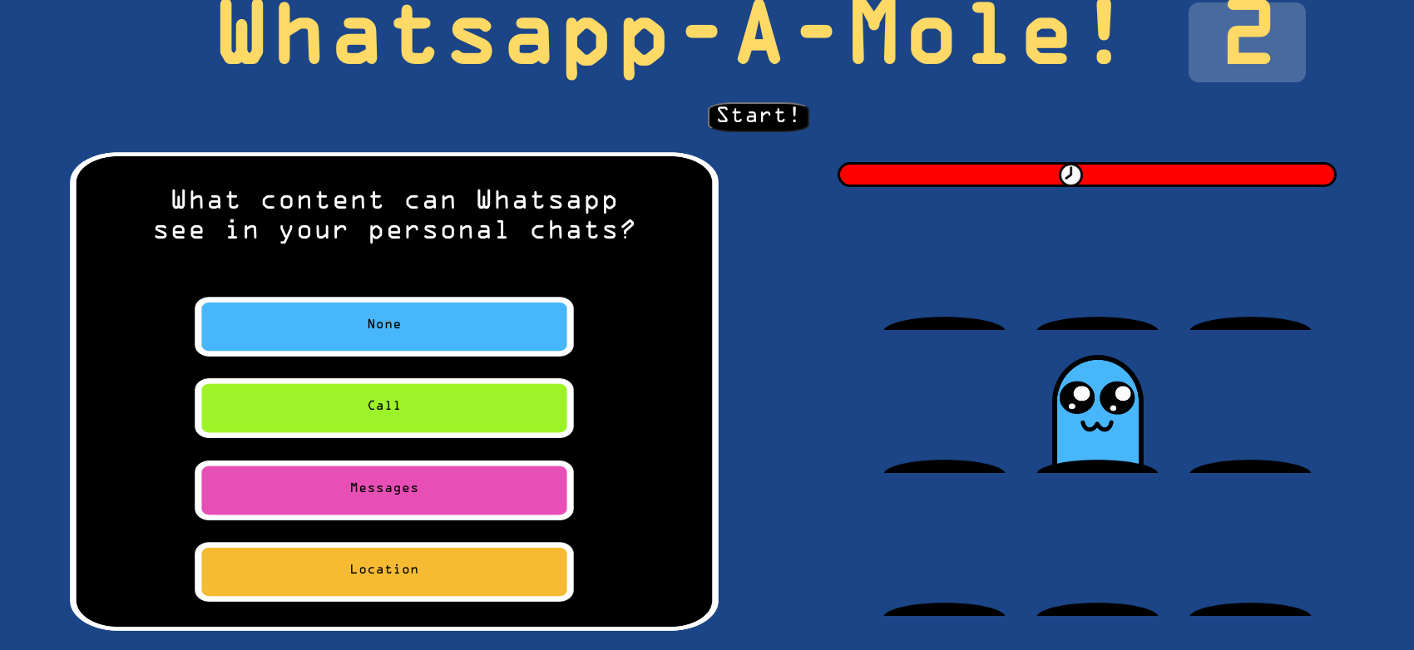
Prototype

Slide 16
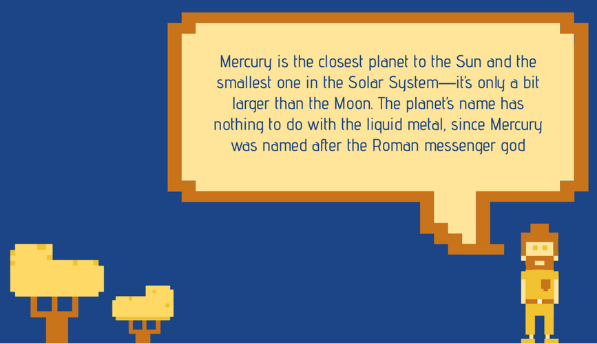
USER EVALUATION #1 & IMPROVEMENTS
> “The game elements seem to be too small”
> “The time limit was too less”
> “The questions are too less in number”
> “No penalty for wrong answers”
> “I did not understand how the game is supposed to be played”
> “The game did not seem engaging enough”
> “I wish I could compete with my friends”
> “I don’t know what answers I got wrong”
> “I did not understand when the game got over”
> “The game seems too easy and too slow”
> “Movements of moles don’t seem random enough”
> “I wish that there was variety in question difficulty”

Slide 17
GAME DEMONSTRATION
https://pankilkalra.github.io/cse648-psosm-project/

Slide 18
USER FEEDBACK
https://docs.google.com/forms/d/1x2d8bfOJ5lcaentCPha73FvhcXd5qfG7CvABjTk83zE/edit#responses
“Very enjoyable, very creative. It's fascinating how a game about WhatsApp privacy policy can be so engaging and competitive with my friends. Kudos!”
“The game was very informative, beautifully organised. I have learnt a lot from it even being a 49 yr old, and I showed this to my kids who enjoy it too. Great Job!”
“It's a great time pass especially in this Covid time and at the same time got to know more about the app.”
”

Slide 19
FUTURE DIRECTION
> Extend Game to different Social Media platforms
> Expand Question Database
> More usability evaluations and improvements in UI/UX
> Make the game popular :D

Slide 20
Blog
https://cse648psosm2021.blogspot.com/2021/05/whatsapp-mole-interactive-game-for.html

Slide 21



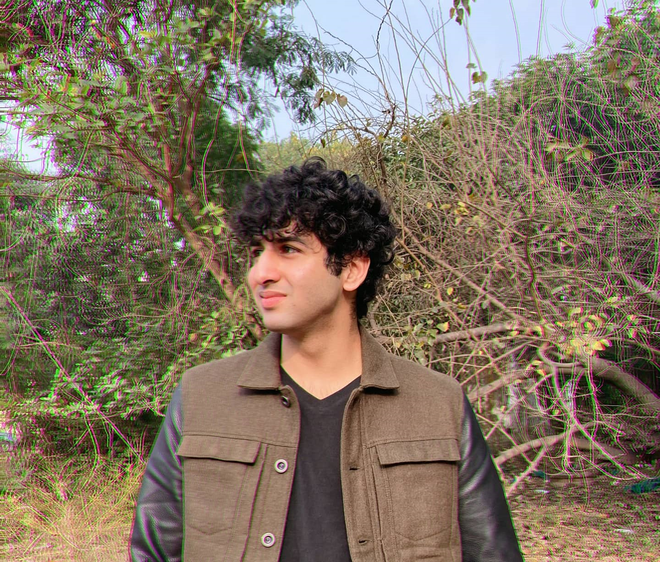




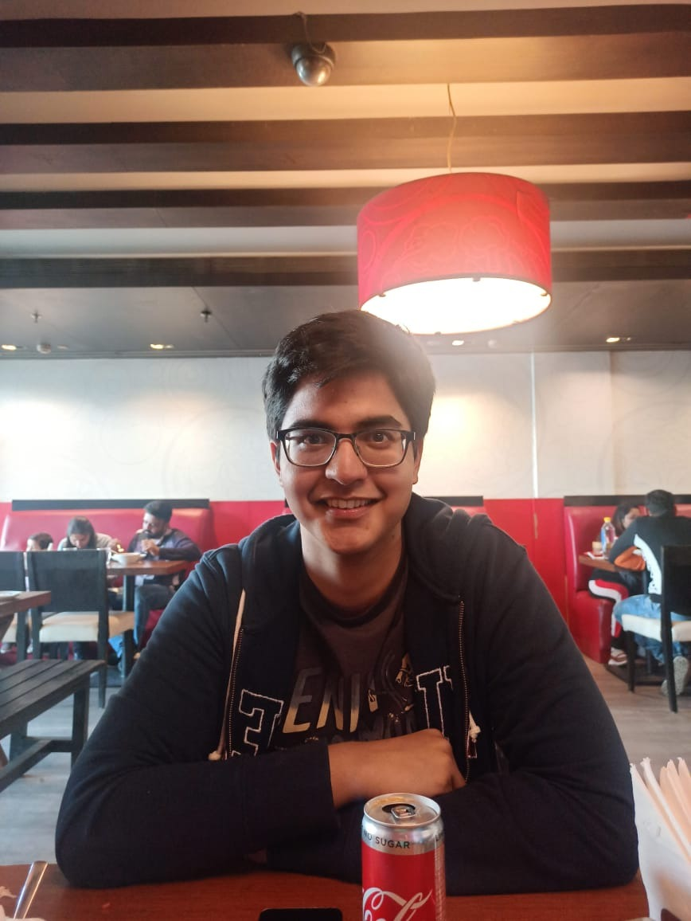
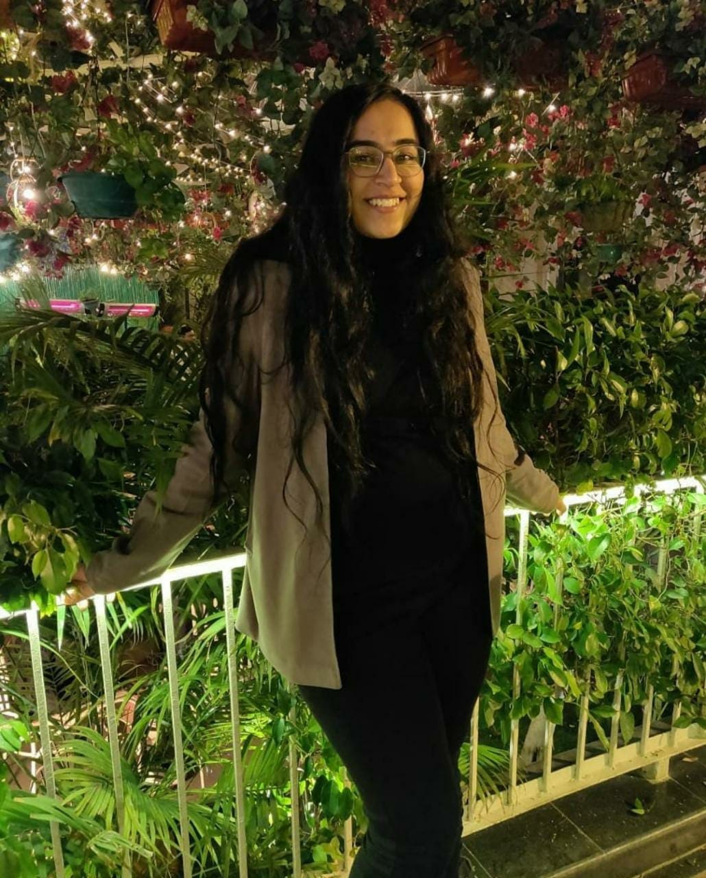


THANKS!
Rishabh Devgon | 2018303
Aneesha Lakra | 2018277
Rachit Bhayana | 2018301
Meeha Tewari | 2017300
Pankil Kalra | 2018061
Daksh Thapar | 2018137
Jasmine Kaur | 2018287
Naman Tyagi | 2018055
Himanshu Raj | 2018038

